Slide 1
Billing Training

Slide 2
Review
Plan Supplemental Benefits
UM Process
FAQs
Claims Submission
Billing Resources
Payment Schedule
Reminders

Slide 3
Supplemental Benefits
6 additional Podiatry Visits
1 Routine Eye Exam (Annually)
Eyewear up to $260
Hearing Exams
Hearing Aids up to $1,800 every two years
Preventive Care
Doctor’s Office Visits

Slide 4
West Virginia Senior Advantage Utilization Management Process
Prior authorization is required for all elective admissions to the Acute Setting.
Notification of emergency admission is required for Admission to Acute Setting with 24 hours of admission.
We do not require prior notification for emergency admissions/transports.
Authorizations can be requested via:
EZNet Provider Portal
Faxing the Plan UM Department
1-800-903-0271
Calling Plan UM Department
1-844-854-6888 option 3
*Note: The Evidence of Coverage is available on the Plan website and includes a complete list of services requiring authorization

Slide 5
West Virginia Senior Advantage Frequently Asked Questions
Q: Does West Virginia Senior Advantage reimburse at RUGS or level of care?
A: 100% of CMS RUGs rates and midnight rules are followed per standard Medicare regulations
Q: Are the MDS’ for West Virginia Senior Advantage handled like other managed care plans?
A: Yes, they should be handled like any other plan that pays on RUGs.
Q: What to tell hospitals/physicians about how to submit claims to West Virginia Senior Advantage:
A: Direct them to the plan website or the Provider Services team at 1-844-854-6888 extension 2004

Slide 6
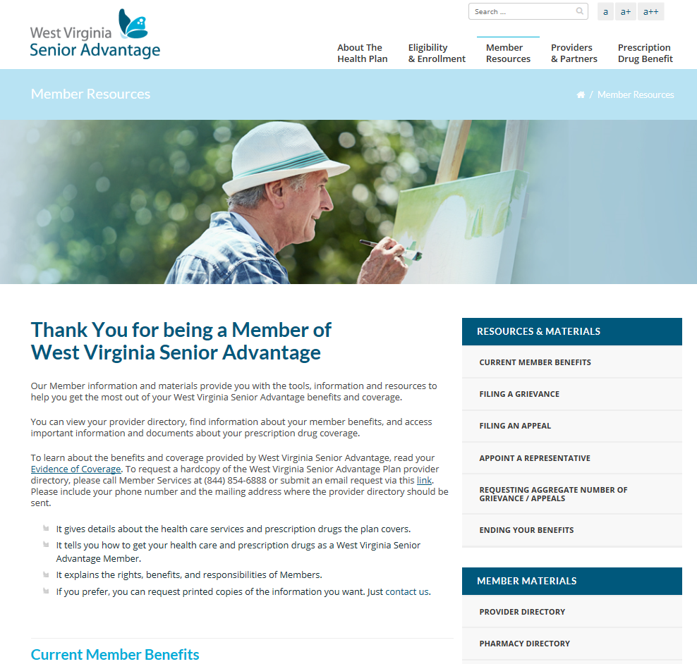
West Virginia Senior Advantage Frequently Asked Questions
Q: How can the facility staff or residents/family members access the complete list of in-network providers for the plan?
A: Via the Provider Directory on the West Virginia Senior Advantage website, under Member Resources.
*Note: Beginning 01/01/17 the Provider Search Portal will be available online

Slide 7
Claims Submissions
West Virginia Senior Advantage follows all Medicare guidelines.
Timely filing requirement:12 months from date of service
Cannot bill future dates of service
Bill West Virginia Senior Advantage in 30 day increments
Acceptable claim forms:
CMS 1500 for Professional Claims
UB04 for Facility Claims
Claims can be submitted via paper, EZNet or EDI
Paper Claims Mailing Address:
West Virginia Senior Advantage
PO Box 908 Addison, TX 75001-0908

Slide 8
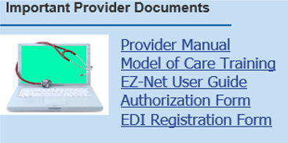
Billing Resources: EZNet
Functionality:
Member Eligibility Lookup
Authorization/Referral Submittal & Inquiry
Claims Submittal & Inquiry
User Guide & Training Video available on home page
Monthly provider trainings offered on last Friday of each month at 12:30 PM EST
https://planprovportal.align-360.com/EZ-NET60WVA/Login.aspx

Slide 9
Billing Resources: Electronic Billing
Claims can be submitted directly through our clearinghouse or through your current system. You can also receive payments electronically, but you need to sign up! Here is how:
EDI Customer Support: 1-888-635-0009, Option 2
Website: http://exchangeedi.com/quick-links
Obtain Companion Guide and Enrollment Form from the West Virginia Senior Advantage website

Slide 10
Payment Schedule
West Virginia Senior Advantage Advantage runs a bi-weekly payment cycle
835s, RAs and Payments will be sent within 30 days of claim received date per Medicare requirements for all claims paid or denied with explanation of status
*Interest will be paid if a clean claim received is not paid within 30 day time frame
Explanation of Benefits will be provided to all members

Slide 11
Reminders
UM Department can be reached at:
Phone: 1-844-854-6888 option 3
Fax: 1-800-903-0271
For help, West Virginia Senior Advantage Provider Services Representatives can be reached at:
1-844-854-6888 option 4
customerservice@westvirginiasenioradvantage.com
Helpful provider information is always available on the West Virginia Senior Advantage website
http://wvsenioradvantage.com/

